Slide 1
Informed Search
CS161
Prof. Guy Van den Broeck

Slide 2
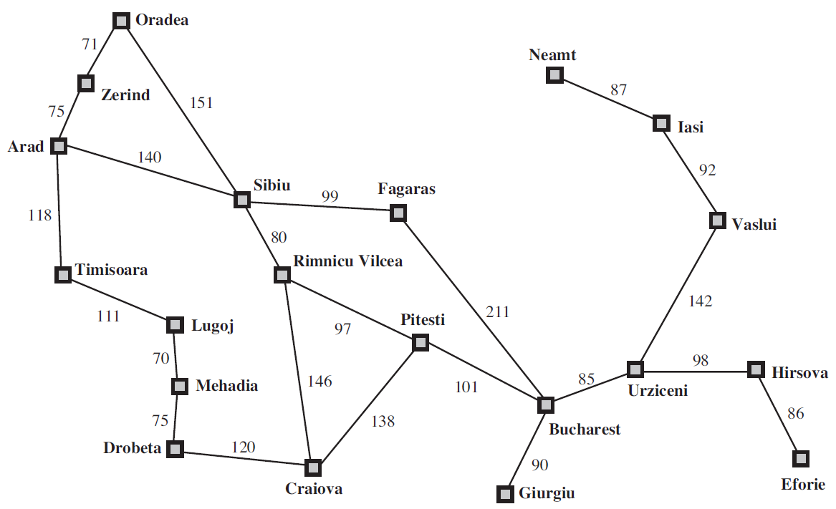
Best-First Search Motivation
Evaluation function f(n)?

Slide 3
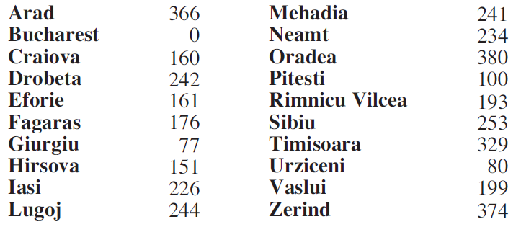
Heuristic Search Motivation
Heuristic function h(n)=

Slide 4
Greedy Best-First Search
Minimize estimated cost to goal
h(n) estimated cost of cheapest path from n to goal
Evaluation function to choose node f(n) = h(n)
Require: h(n) = 0 when n is goal
Where does h come from?
Not easily read from search problem formulation
Application-specific
E.g., straight-line distance from map coordinates

Slide 5

Arad to Bucharest?
Heuristic function h(n)=

Slide 6
Properties
Arad to Bucharest 32km longer than optimal
Minimal search cost:
Solution was found with no unnecessary expansion!
Optimal? No
Complete?

Slide 7
Iasi to Fagaras?
Heuristic function h(n)=

Slide 8
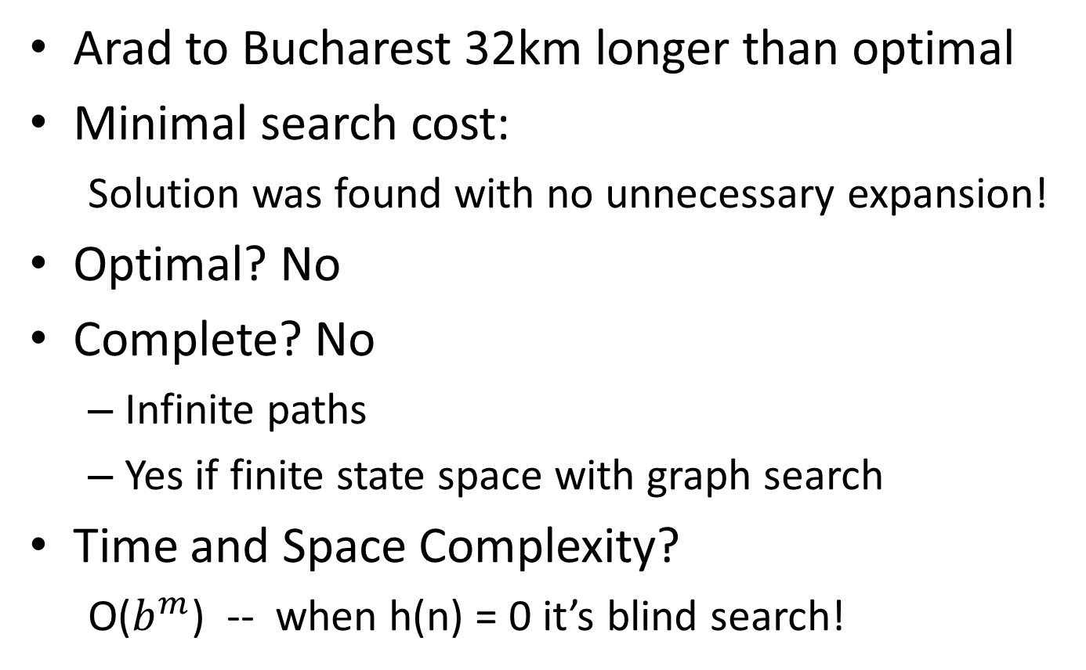
Properties

Slide 9
How to fix this mess?
Greedy best-first search with heuristic h(n) is too greedy
no idea where it came from…
Uniform-cost search with cost g(n) is too conservative
no idea where the goal is…
Solution?

Slide 10
A* Search
f(n) = g(n) + h(n)
g(n) = distance from start
h(n) = heuristic
Estimated cost of cheapest solution through n

Slide 11
A* Search

Slide 12

Heuristic Properties

Slide 13
Optimality of A*

Slide 14
Memory-Bounded Heuristic Search

Slide 15
Constructing Heuristics

Slide 16
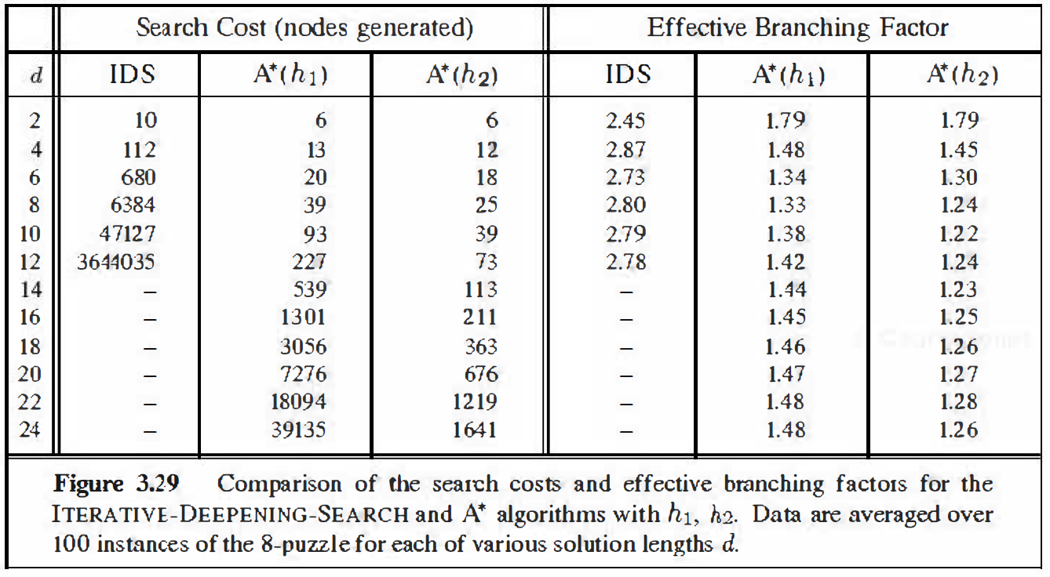
Effective Branching Factor

Slide 17
Relaxed Problems

Slide 18
Subproblems

Slide 19
Korf’s Breakthroughs
15-puzzle optimal (1985)
24-puzzle optimal (1996)
Rubik’s cube optimal (1997)
15-puzzle exhaustive (2005)
…

